Slide 1
UNOS ASSISTANT
Showcase & Features

Slide 2
What is UNOS-Assistant?
Universal Non-Propietary Operations System
AI Framework Designed for
Creating Personalized Assistants

Slide 3
Core Concepts
E.T.A Design Principle for Open-Projects
Expandability: Integrate with Other Systems
Transparent: Everything is Open to Modify
Adaptability: Customize to Your Preference

Slide 4
Capabilities
House or Work Automations
Hands-Free Operation
Act as reminder and planner
Be your friend (just me? really?)
And More!

Slide 5
UNOS Operation Process
Output to User
Outputs the information in the forms that the user can understand such as text and ui.
03
Receive Input from User
Input can either be through manual input or voice recognition
01
02
Splitter Processing Unit
Splitter Processes information given and uses modules to respond.

Slide 6
Primary System Modules
BootLoader: Config & Setups
Interface: Handles Input and Output
Splitter: Handles Analysis
Plugins: Analyze and Output Answers
Speech: Handles Recognition and Synthesis
Autofixer: Fixes Errors Automatically
Management: Handle Updates and Training

Slide 7
Splitter Analysis System Example
Collect Output
Collect all the information provided by plugin and returns the data back to interface.
03
Check list of all plugins
Check to see how many plugins are enabled to be use for processing
01
02
Use plugin that can process
Compare to see if that plugin reports back for use in processing.

Slide 8
Current Analysis Adaptors Included
Math – For Doing Maths
Time – For Getting Current Time
Manager – Management of AI Systems
Scraper – For Web Search Results
Weather – For Getting Weather Data

Slide 9
Multiple Adaptors Scenario
Ask the user to provide more context in the category of question.
Process with the adaptor that has the context
Returns the output like usual
If not, use fallback adaptors

Slide 10
Fallback Adaptors
Fallback adaptors are specialized adaptors to process the question if all of the other adaptors failed.
There are a few adaptors provided with UNOS

Slide 11
Fallback Adaptors Included
MCAS: Built-in Accurate Response System
SCAS: Build-in Faster Response System
RASA: Integrates with RASA AI System
CHBT: Integrates with ChatterBot
GPT-3: Integrates with OpenAI System

Slide 12
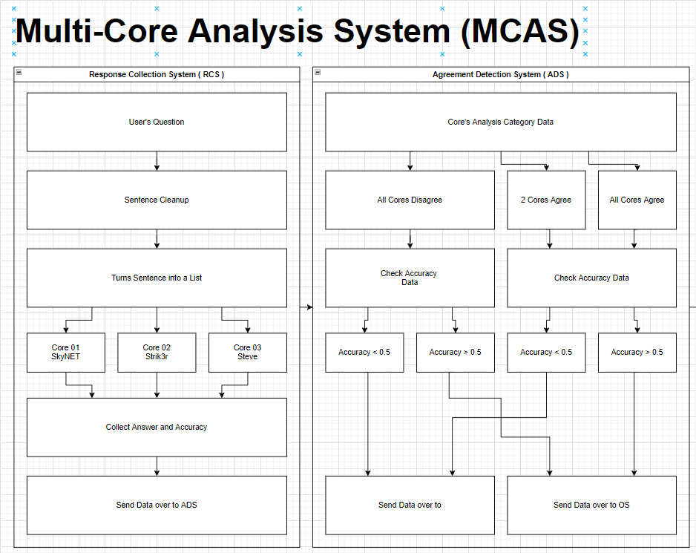
MCAS System
Multi-Core Analysis System or MCAS is a system designed to have 3 Cores, different neural network AIs, running analysis of the question at the same time and output the most accurate answer.

Slide 14
Self-Learning MCAS
If learning is enabled MCAS will learn based on confident answers
This ensures that MCAS will be smarter as time goes on.
Still need category to be provided

Slide 15
Cores System
Cores are the different configurations of Neural Networks models. There are currently 3 in the MCAS. Think of them as different persons thinking of an answer.
Included are SkyNET, Strik3r and Steve

Slide 16
Planned Features
Sarcasm Intensity Selection
Voice Quality Selection
Mood Changes w/ Time
Gender & Species Selection
Profile Selection
Regional Accent / Dialect Selection
Motivational Quotes (AI Style)

Slide 17
Supported Platforms
 | Windows | MacOS | Linux/Unix
CLI Interface | Yes | Untested | Untested
GUI Interface | In Progress | Planned | Planned
Web Interface | Planned | Coming | Coming

Slide 18
Requirements
Tested with Python 3.7.5, 3.9.10 & 3.10.2
Supported Versions: Python 3.5+
Libraries Used:
Machine Learning: TensorFlow + NLTK
Speech Libs: DeepSpeech + GoogleCloud
Integrations: GoogleAPI, Rasa & More

Slide 19
Download & Installation
Visit unos.MostlyWhat.cf or GitHub
Clone or Grab the Latest Build
Pip dependencies & Update Credentials
Run Unos.py file!
www.github.com/mostlywhat/unos-assistant

Slide 20
UNOS IN ACTION

Slide 21
It’s Open-Sourced
Always Updated
100% Free to Use
Licensed under AGPL-3
The program is in constant development
For Personal Usage, Commercial Needs a License

Slide 22
Open to Funding & Backings
The project is still in its early stages of development.
If you like the project, please consider donating to support the project.

Slide 23
V1.0 Coming Soon
September 2022

Slide 24
END OF SHOWCASE
Any Questions

